Slide 1
Installation of Dataset on Cloudera (Course-3)
Specially for those facing error
“env: 'jupyter': No such file or directory”

Slide 2
Since you are here that means you are getting message that says
“env: 'jupyter': No such file or directory”
In case you have tried everything available on internet and its not worked for you then this document means a lot for you.
I will just recommend you to start it on fresh that means just delete files from Downloads folder like extracted big-data-3 file. Do not delete big-data-3.zip file.
Delete Anaconda3 folder also from the cloudera folder if folder exists.
If you done with deleting or undoing your previous work just follow the process from STEP 4.
Incase you have deleted the big-data-3.zip file or not downloaded it yet, then start from STEP 1

Slide 3

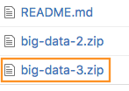
Step 1. Start the Cloudera VM. Most of the Hands On exercises in this course use the Cloudera Virtual Machine, so we will download the datasets onto the VM. Start the VM in VirtualBox and perform the remaining steps in the VM.
Step 2. Open a web browser. Open a web browser by clicking on the web browser icon in the top toolbar.
In the web browser, enter the following for the URL:
http://github.com/words-sdsc/coursera
Step 3. Download the datasets. Click on big-data-3.zip:

Slide 4

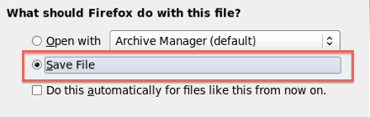

Click on the Download button:
In the dialog, select Save File:
Click OK, and the file big-data-3.zip file will be downloaded to the Downloads directory.
Step 4. Uncompress the datasets. Open a terminal shell by clicking on the terminal shell icon in the top toolbar.

Slide 5
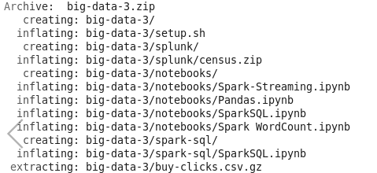
In the terminal, run:
cd Downloads
unzip -o big-data-3.zip
Then things will be extracted like -

Slide 6
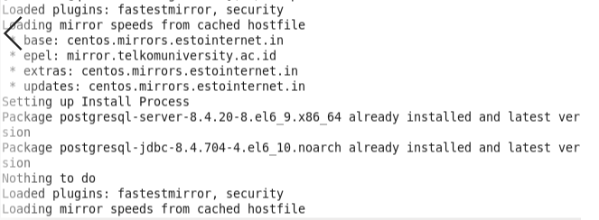
Step 5. Install tools. Change directories to big-data-3 and run setup.sh to install tools and libraries.
cd big-data-3
./setup.sh
Now things will be look like-

Slide 7
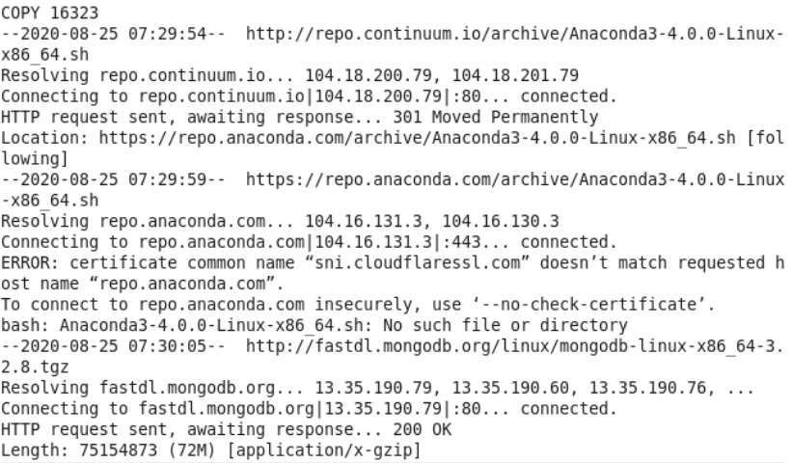
In the meanwhile of installation if you find something saying no such file or directory , it means anaconda is not installed right now. So you need to install it later after finishing of this ongoing installation.

Slide 8

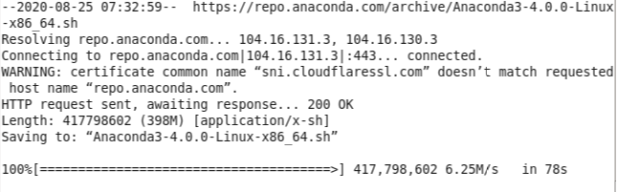
So after finishing the installation from setup.sh
Install anaconda using the following command:
wget https://repo.anaconda.com/archive/Anaconda3-4.0.0-Linux-x86_64.sh --no-check-certificate
It will look like :

Slide 9
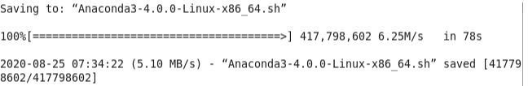
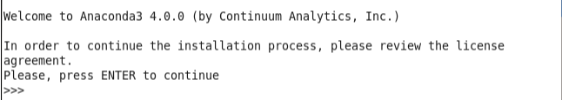
Later it will finish something like this:
So now you need to run the following command:
bash Anaconda3-4.0.0-Linux-x86_64.sh
And it will executes like :

Slide 10
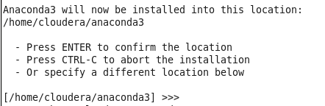
Now press enter,
after this license information will appear , so you can skip it by clicking space and q key.
Now it will ask for you agreement so put yes in prompt appeared like given below:-
After this the screen given below will appeared,
Now press enter.

Slide 11
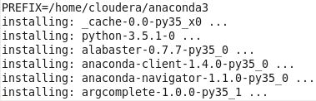
Now it will start installing anaconda components to your system like given below:
Now, it will ask for the path , so you need to say yes to it.

Slide 12
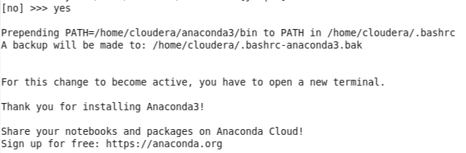
It will look like and “Thank you for installing Anaonda3!” message means you are done now.
Now close this terminal window and open new one and now type pyspark there.
It will open your jupyter window on browser.

